Slide 1
Welcome to Houston!!!
GSBS Grad Student Housing & Commute Insights
(Updated April 2025)

Slide 2
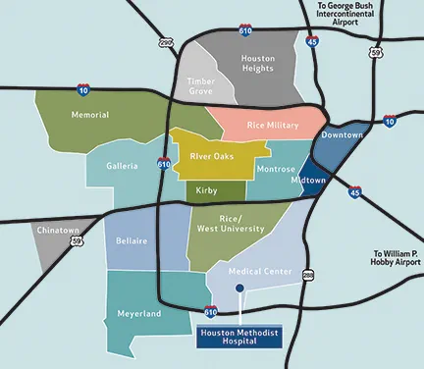
Introduction to Houston Neighborhoods
GSBS

Slide 3
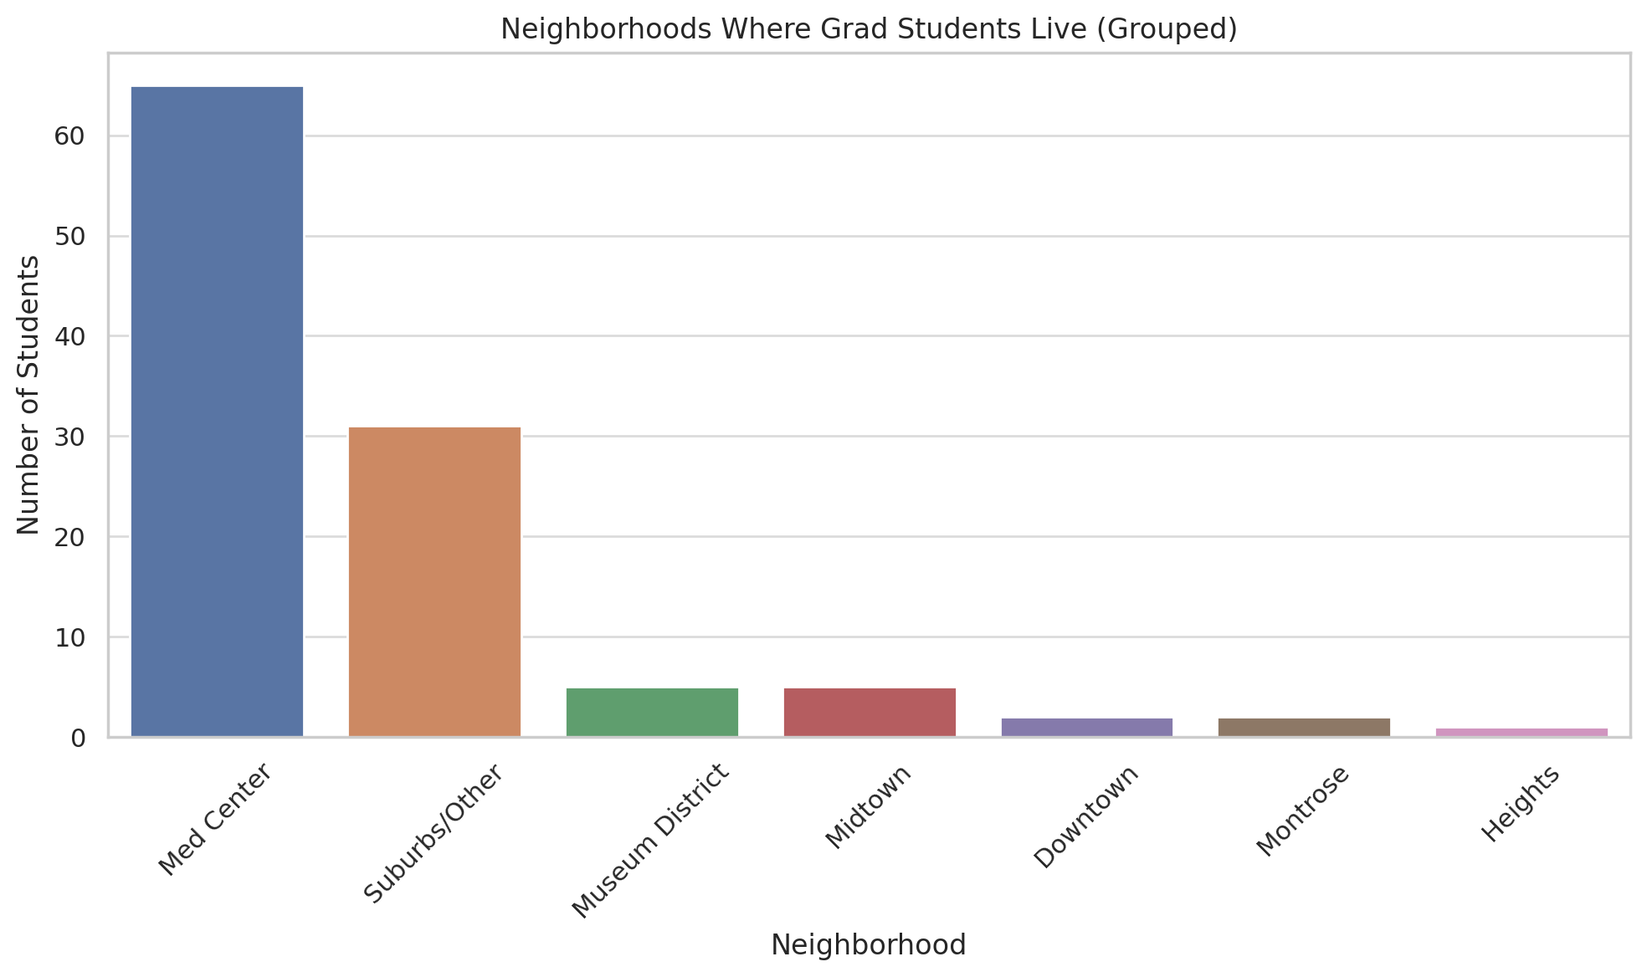
Where do grad students live?
Most students live in the Med Center, Museum District, or Suburbs
Med Center is by far the most common
Suburbs like Pearland offer more space but require a car
Montrose and Heights have great vibes but longer commutes

Slide 4
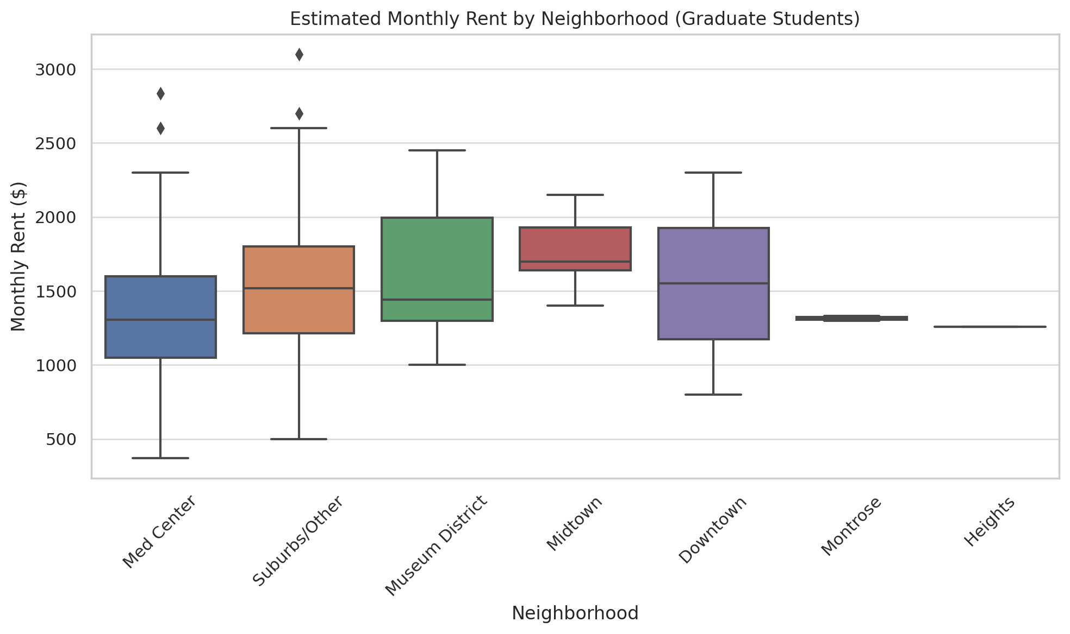
Breakdown of cost by neighborhood

Slide 5
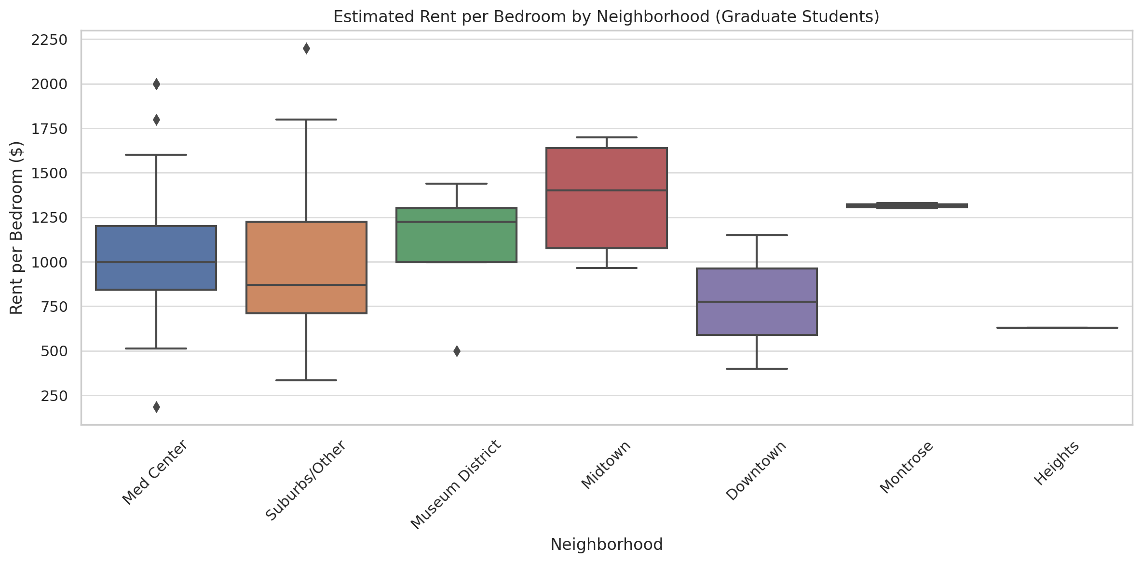
Breakdown of cost adjusted for bedrooms

Slide 6
Most Common Neighborhoods: Vibes and Cost
Med Center
~$1,255/mo
85% recommend
Walkable, close to campus
Museum District
~$1,440/mo
80% recommend
Quiet, green, near TMC, parks & museums
Montrose
~$1,315/mo
100% recommend
Artsy, LGBTQ+ friendly, walkable, social
Heights
~$1,260/mo
100% recommend
Residential, young professionals and families, good food, best w/ car
Suburbs (Pearland, etc.)
~$1,360/mo
83% recommend
More space, budget and family-friendly, long drive and high commuting costs
* costs are estimated per bedroom!!!

Slide 7
Highly Rated Apartments (2+ Grad Student Responses)
8181 Med Center
100% would recommend
8181medcenter.com
"Close to campus, safe, and has a shuttle!"
Great for: Students without a car who want to walk or shuttle to campus.
Helix at Med Center
100% would recommend
helixatmedcenter.com
“Really modern and walkable. Gym is solid.”
Great for: Students who prioritize amenities and safety.
UT Housing (in Med Center)
100% would recommend
uth.edu/housing
"Affordable, quiet, and full of other grad students."
Best for: First-years, international students, or those looking for simple & secure housing.
Also mentioned: Broadstone Toscano, Portico Kirby (but with mixed reviews)

Slide 8
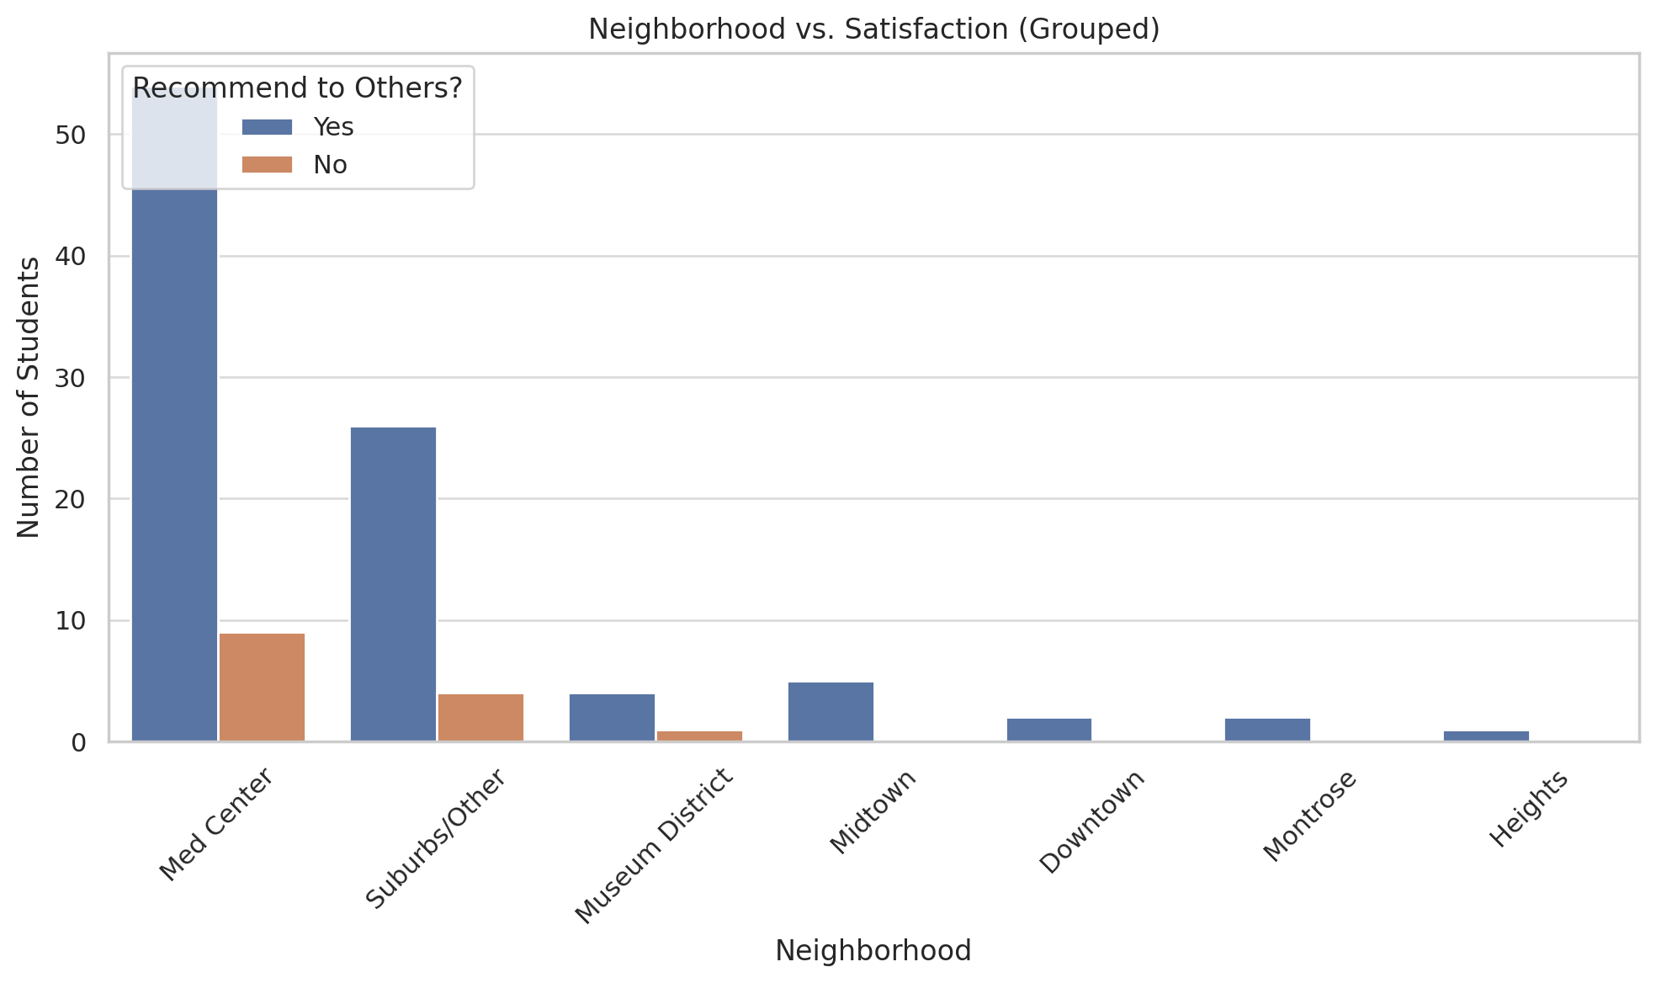
Do people recommend their neighborhood?

Slide 9
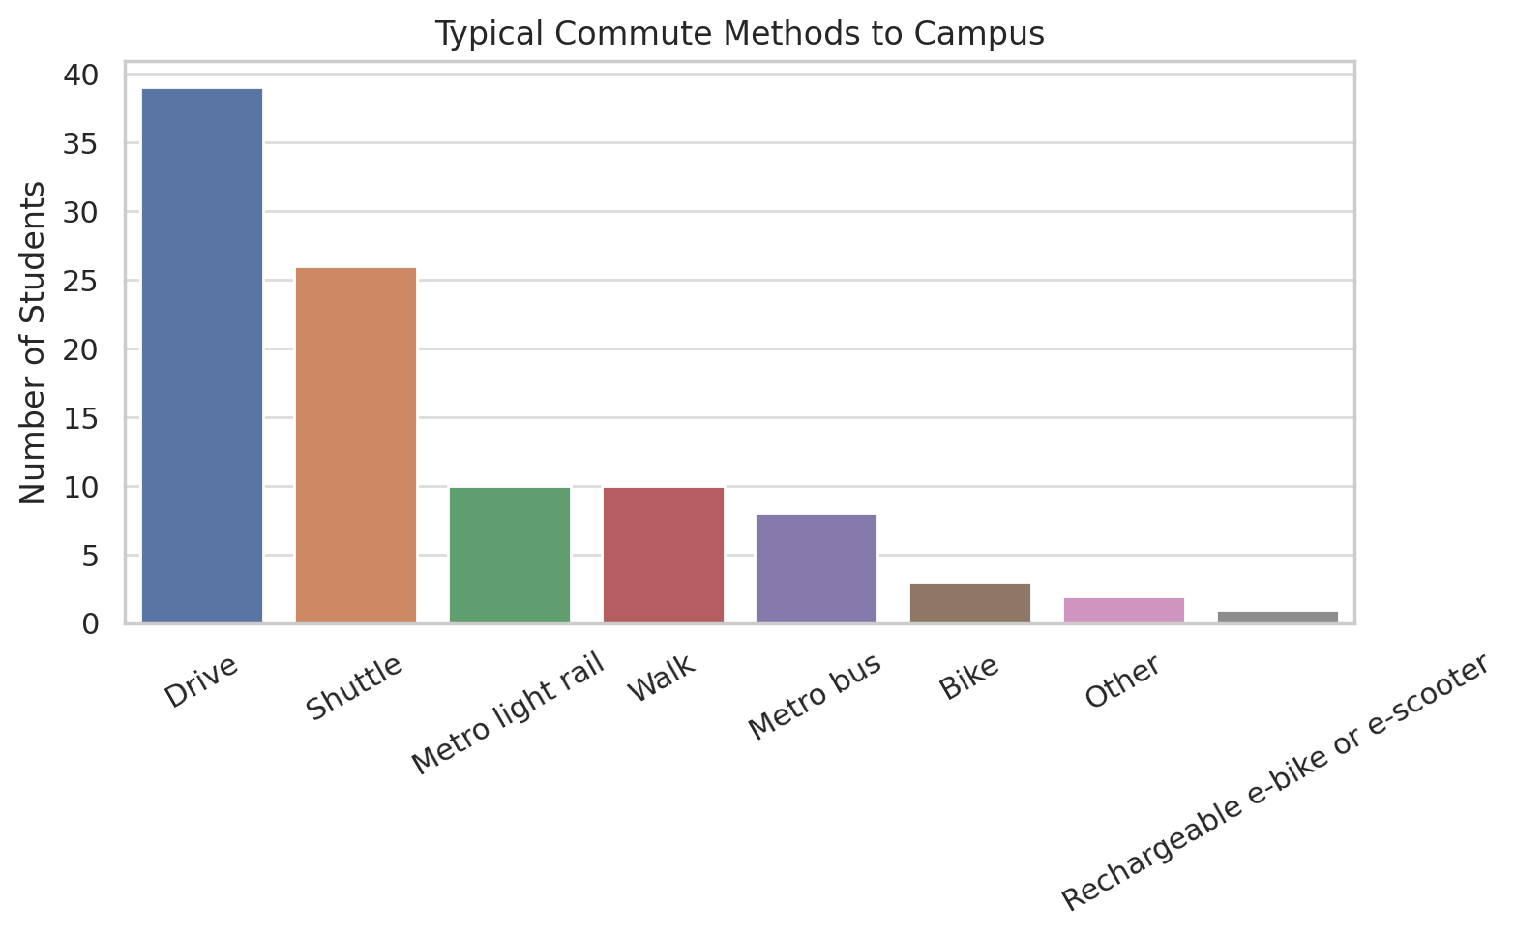
How do students typically commute?

Slide 10
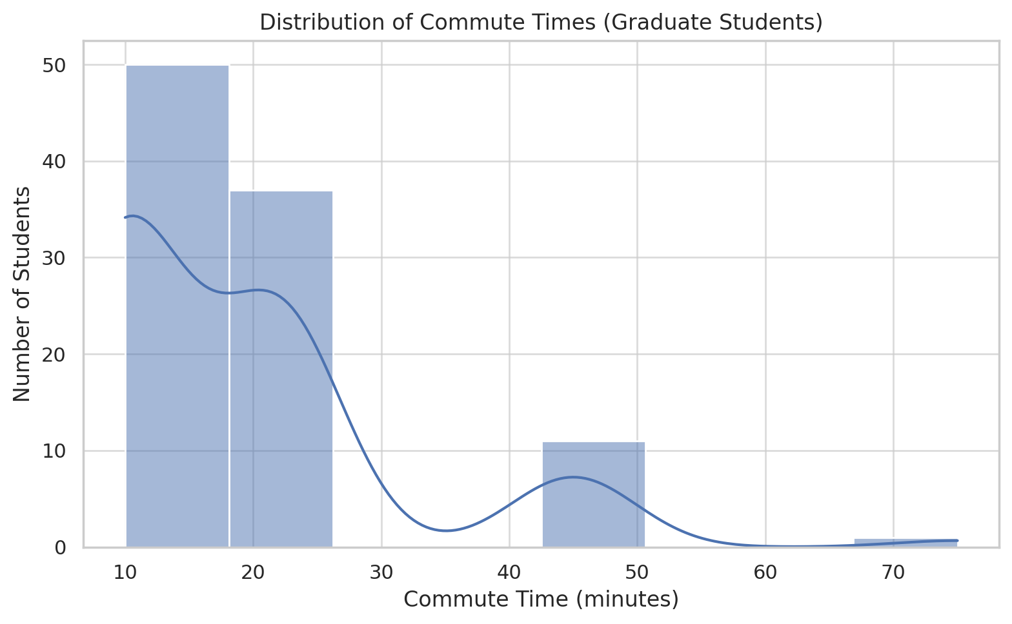
How long is a typical commute?
Most students have a commute under 30 minutes, but there’s a smaller group — especially in the suburbs — who are commuting over an hour.

Slide 11
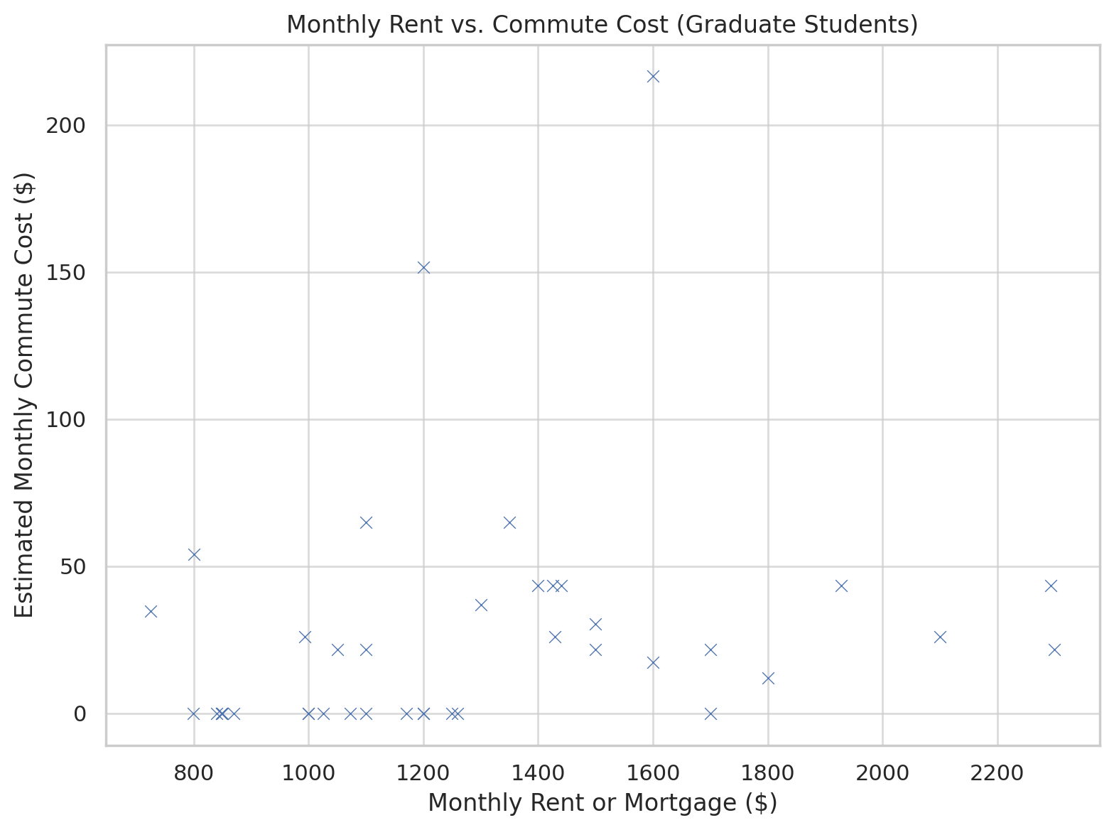
Commute costs versus rental costs
Some people can save on rent by living farther out, but those savings may get eaten up by higher commute costs. It’s a good reminder to think about your total monthly cost.

Slide 12
Some Questions to Help Decide Where to Live
Do you have a car and don’t mind a commute?
→ Yes: Could consider the suburbs, Heights, Pearland
→ No: Stick to Med Center, Museum District, Montrose
Want a social scene?
→ Yes: Montrose, Midtown, Heights
→ No: Med Center, Suburbs
Tight budget?
→ Consider UT Housing, roommates, or suburban apartments
Prioritize proximity and want a simple commute?
→ Med Center wins hands down

