Slide 1

Wellness Check-in
GSBS Virtual Wellness Series: Coping through COVID-19

Slide 2
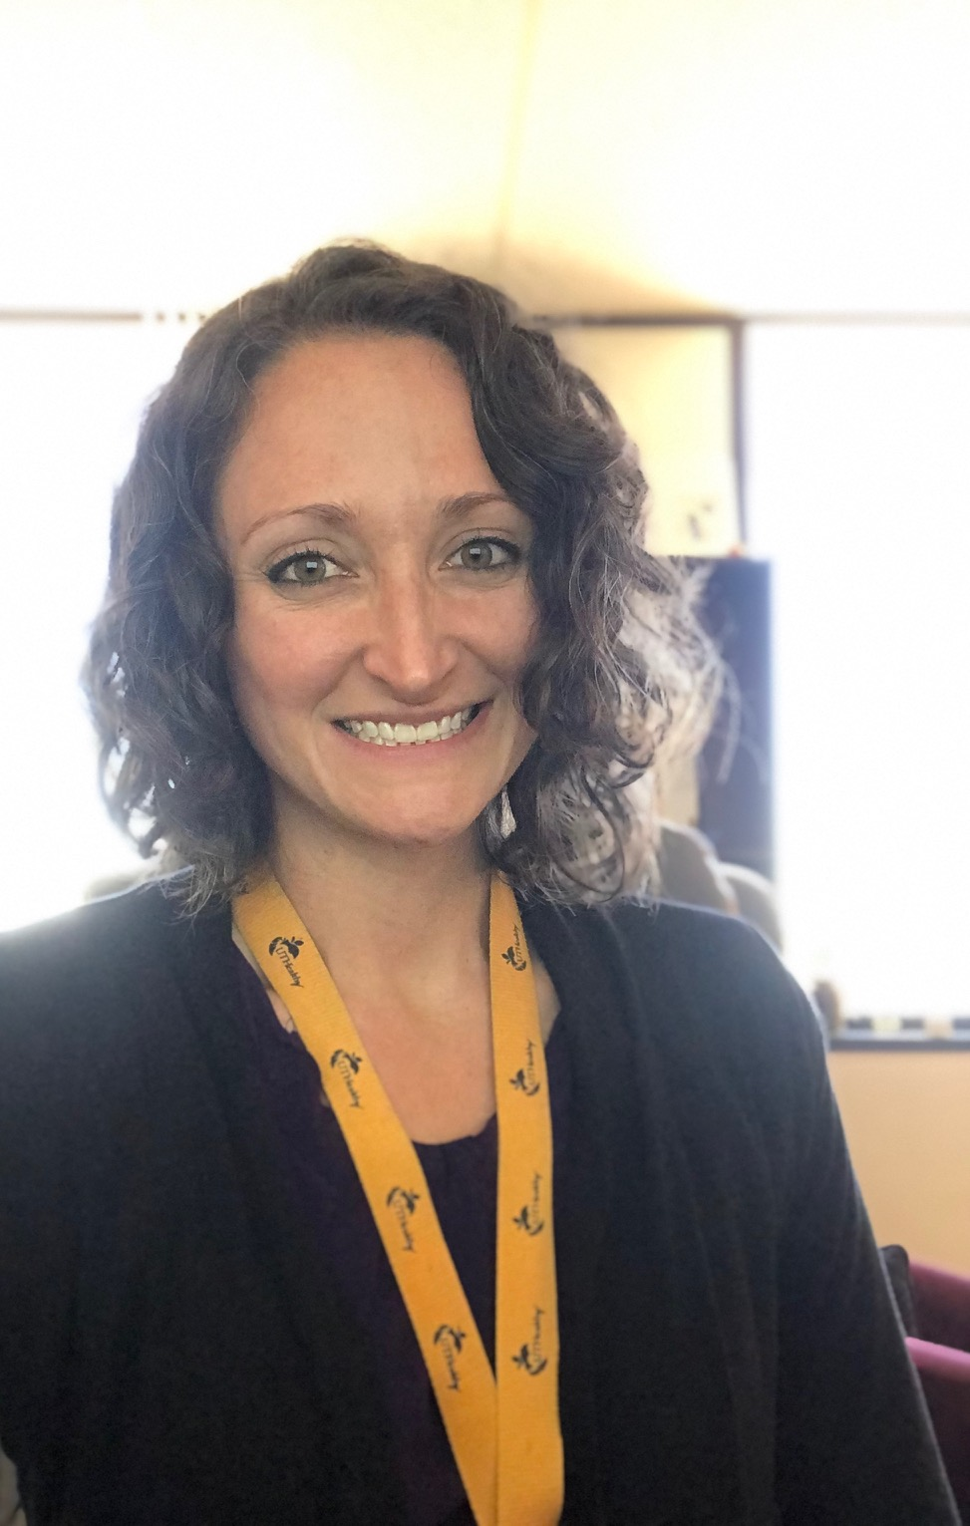

Meet Your Presenters
Robin Dickey, PhD, MA, LPC
Faculty Assistance Specialist
UTHealth Faculty Assistance Program
Office of Employee Assistance Programs
Sharlene Johnson, LPC-S, LBSW, LCDC
Senior Assessment and Referral Specialist –External
UTHealth Employee Assistance Program
Office of Employee Assistance Programs

Slide 3
Agenda
Review of content from previous presentations
Review of resources
Wellness Check-ins
What have you implemented?
What is working well for you?
What areas could use some attention or focus?

Slide 4
Transitioning From Bench To Home: Best Practices For Working Remotely

Slide 5


Working from Home Create a Designated Work Area
Factors to consider:
Location
Lighting
Noise level
Physical comfort

Slide 6

Working from Home Stay Connected

Slide 7
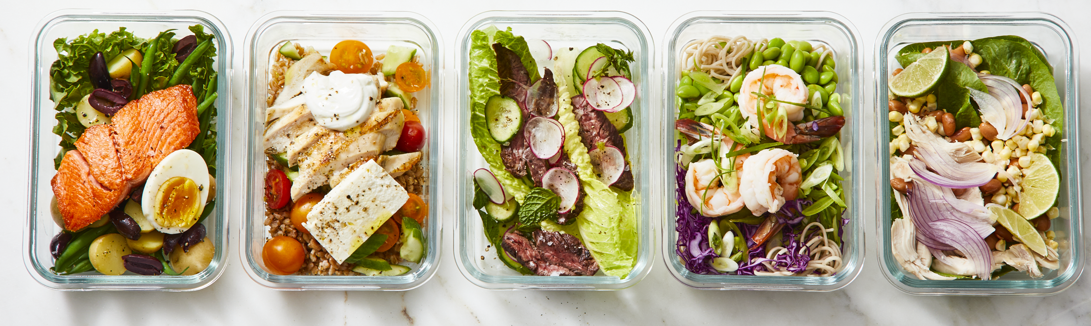
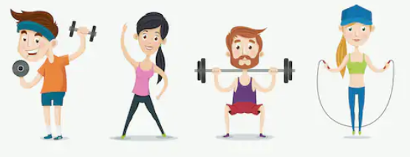
Working from Home Stay Healthy
Healthy Eating
Exercise
Stock your kitchen with healthy foods
Meal prep
Drink water!
Stress and anxiety
Energy
Schedule a workout into your day

Slide 8
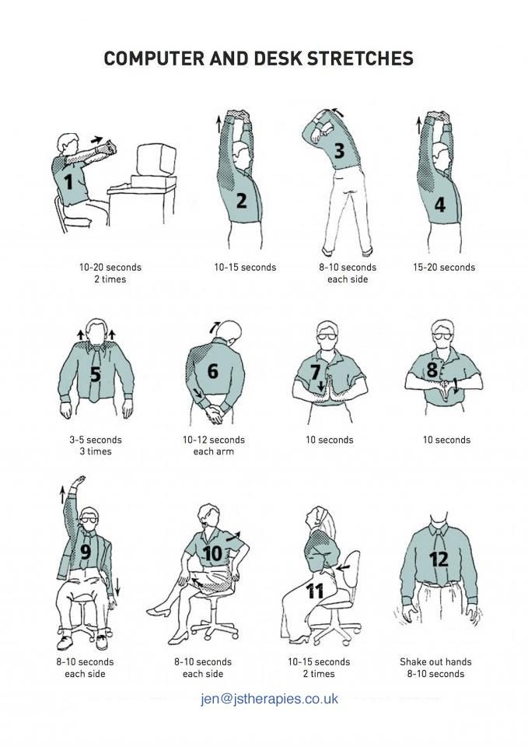
Take breaks often, and stretch!

Slide 9

Time Management What Can You Do?
Time Block
Hold a period of time and regularly keeping it free from all meetings, calls and miscellaneous interruptions.
Having it available for whatever you most need to work on.
This technique enables you to catch up with things you know are important but aren’t getting done - and therefore a cause of stress or anxiety.
The amount of time you can block varies by day, week, month, etc. but is a strategy that can be implemented at any time.

Slide 10
Time Management Schedule Your Day
Take regular breaks
Take a lunch break
Plan a morning and shutdown ritual
Morning-plan your day and review your to-do items
Shutdown-have a plan you trust for task completion or confirmation that tasks will be revisited when the time is right (review during morning ritual).

Slide 11
Communicating During COVID-19: Skills for Conflict Resolution and Difficult Discussions

Slide 12
Effective Communication
RESPONSIBLE
Own your feelings, opinions and actions
OPEN
Listen to and validate others’ opinions, values, preferences
HONEST
Tell the truth unless doing so would hurt you or others
DIRECT
Say what you mean, mean what you say…focus on the main issue

Slide 13
Active Listening Techniques
Validating: acknowledges the worthiness of their POV
Reframing- changes a negative statement into a more positive statement that is future-focused, removes blame/accusations
Reflecting – the listener identifies the feeling behind the speaker’s thought statement and communicates it back to the speaker

Slide 14
Positive Outcomes
Increased motivation and creativity
Healthy interactions/involvement
Number of identified alternatives increased
Increased understanding of others
People clarify ideas more effectively
Feelings aired out
Opportunity to change bothersome things

Slide 15
Thomas Kilman CR Mode Instrument
Competitive
Collaborative
Compromising
Avoiding
Accommodating
Notes:
When you compete, you seek to win while the other party loses.
When you collaborate, you cooperate with the other party to resolve a common problem with mutually satisfying outcomes.
The compromiser looks for a fair and equitable solution split between positions.
You join with the other party to compete against the situation instead of each other.
The avoider side steps or withdraws from the conflict.
Those who accommodate put aside their needs and desires and give into others requests or demands

Slide 16
Six Steps to Resolving Conflict
Acknowledge that conflicts exists
Identify the real conflict
Hear all points of view
Together explore ways to resolve the conflict
Gain agreement and responsibility for a solution
Follow-up to review the solution

Slide 17
How to Discuss What Matters Most
What happened - be open to the person’s POV, recognize your contribution to the situation and theirs
Feelings- identify and understand your feelings, and share them clearly and acknowledge the feelings of the other person
Identity- learn which issue is most important
Letting go- determine which issues to discuss and which to let go

Slide 18
Managing Stress and Anxiety During COVID-19

Slide 19
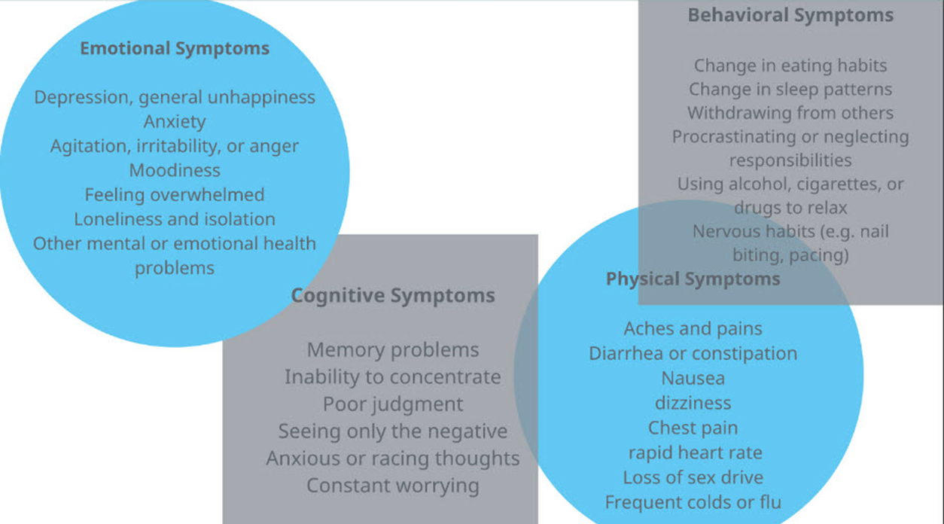
Stress Symptoms

Slide 20
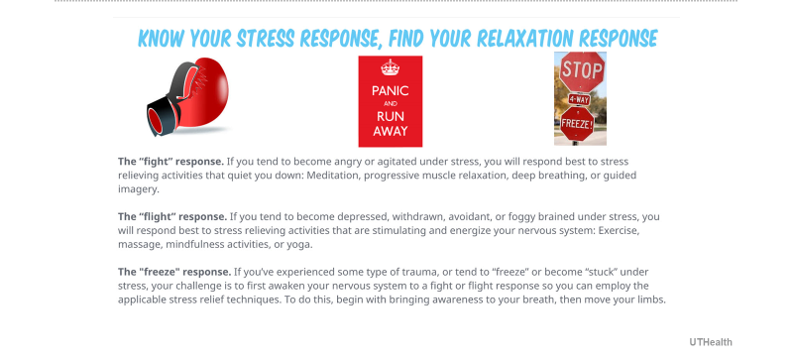
What can you do? (Learn how to) Relax!

Slide 21
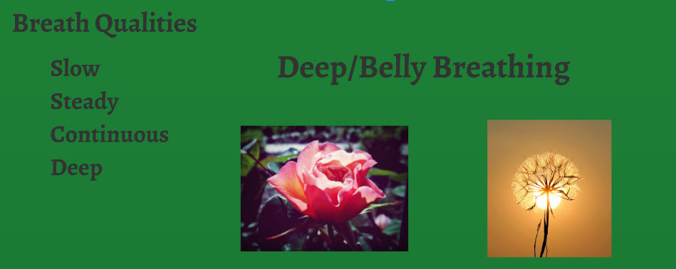
Breathing for stress reduction

Slide 22
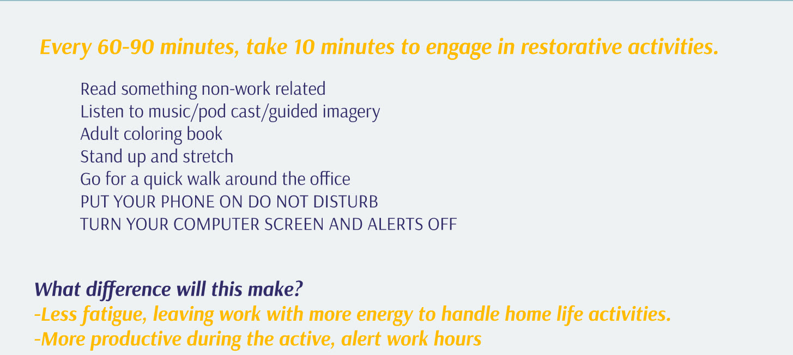
Time Blocking
Our entire body goes through cycles (ex. sleep, breath, heartbeat). The brain has higher to lower states of alertness during the day. To maximize your output, it is vital that you honor these peaks and valleys by balancing concentrated, focused time with relaxation and integration.

Slide 23
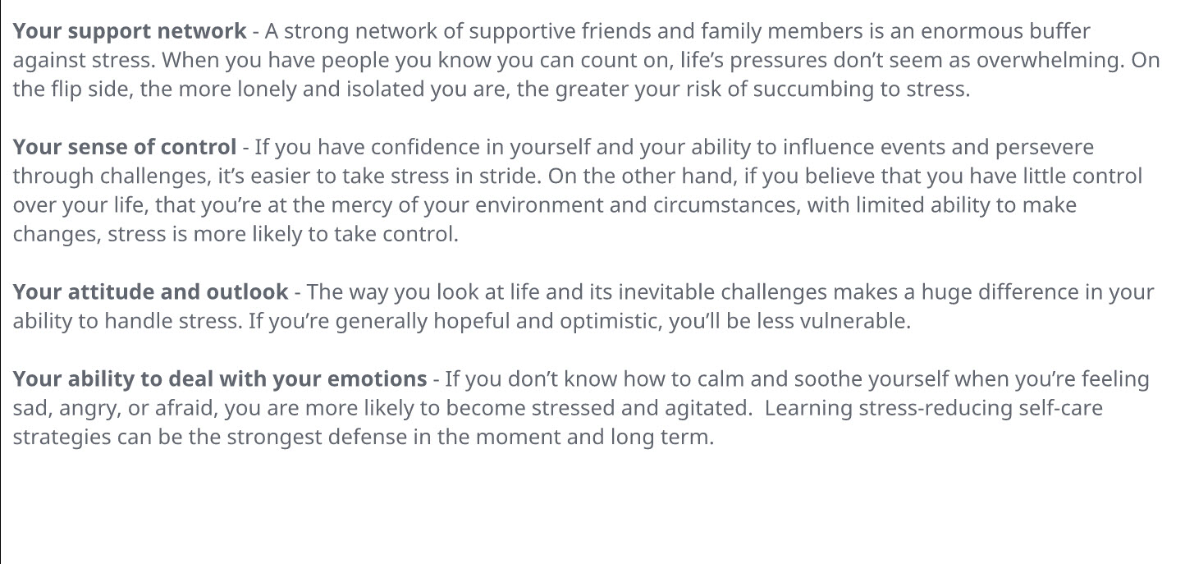

What Can You Do? Know your resources!

Slide 24
Contact the EAP
UTHealth Employee Assistance Program (EAP)
Phone: 713-500-3327
Website: https://inside.uth.edu/eap/employee-assistance/index.htm or go.uth.edu/eap
EMOTIONAL HEALTH RESOURCES IN THE TIME OF CORONA VIRUS
https://inside.uth.edu/eap/employee-assistance/corona-coping-resources

Slide 25
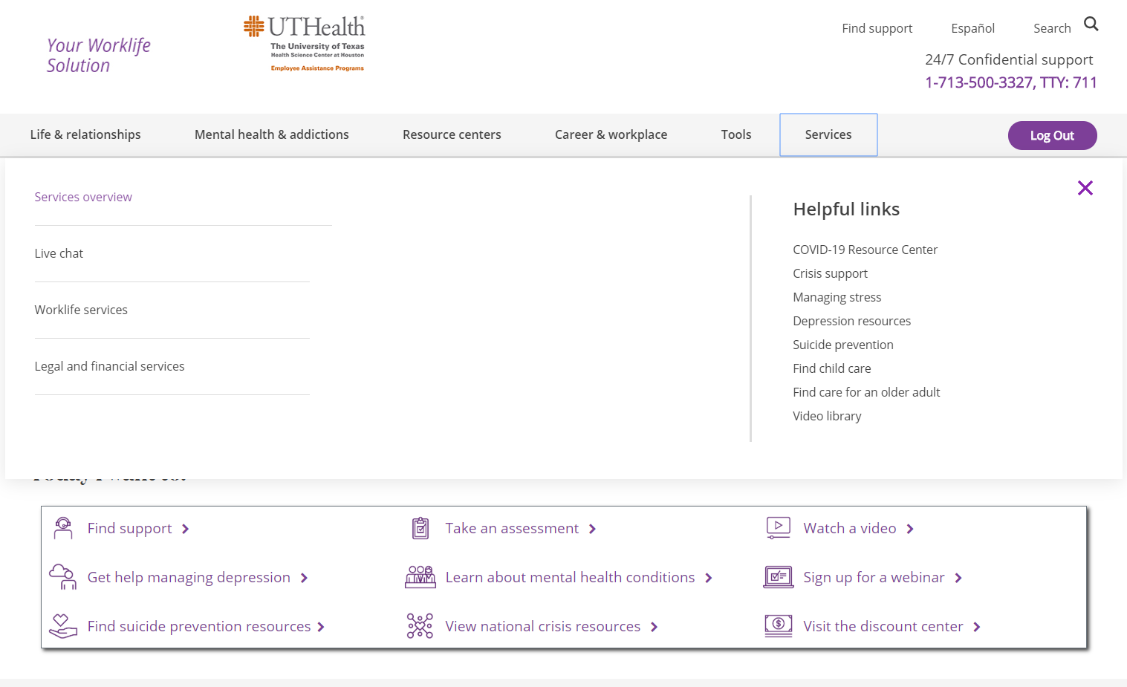
Know Your Resources
www.mylifevalues.com
Username and Password: uth

Slide 26

Discussion Q&A

